Slide 1
CSE 4539 (CSE) / CSE 4581 (BScTE (2yr) 1st Sem)
: Web Programming
Blocks and Inline Element in HTML
Department of Computer Science and Engineering
Islamic University of Technology
Notes:
Assalamualaikum, good day my respected teachers, audiences. Today I am going to present my thesis paper titled “Class Specific feature Selection for High Dimensional low sample size Data”. I am Nazmul haque and my supervisor is Dr. Mohammad Shoyaib.
Before going in detail about my Literature review, I would like to give an outline of my whole presentation.

Slide 2
Contents
Contents
Inline Elements
Block Elements

Slide 3
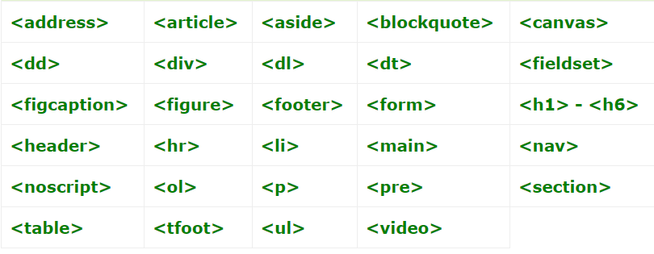
Contents
Block Elements
Block Elements Block level elements appear on the screen as if they have a line break before and after them. A few block elements are listed below.
List of HTML Block Elements:

Slide 4
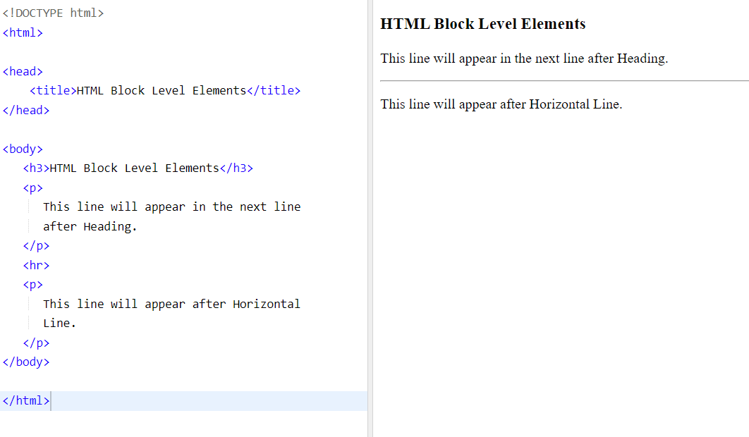
Contents
Block Elements

Slide 5
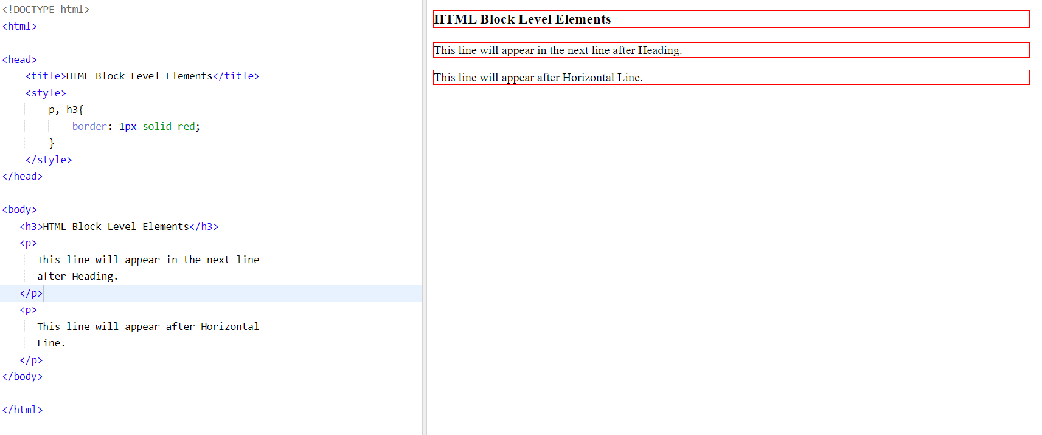
Contents
Block Elements borders

Slide 6
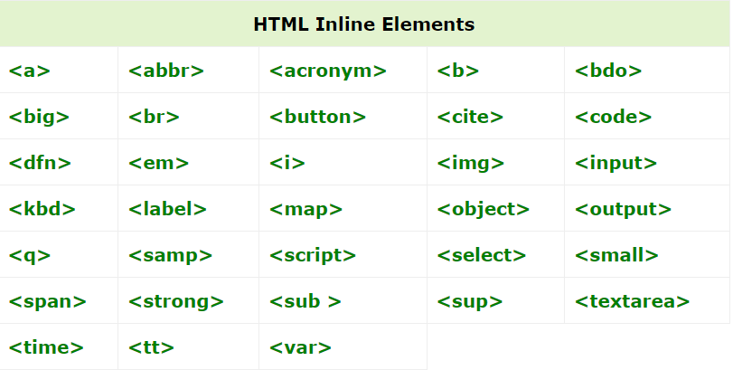
Contents
Inline Elements
Inline elements, on the other hand, can appear within the same line and do not start a new line on their own. Some common inline elements are as follows:

Slide 7
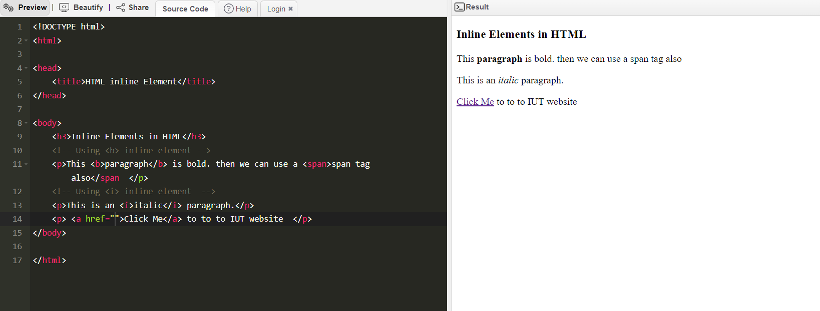
Contents
Example of Inline Elements

Slide 8
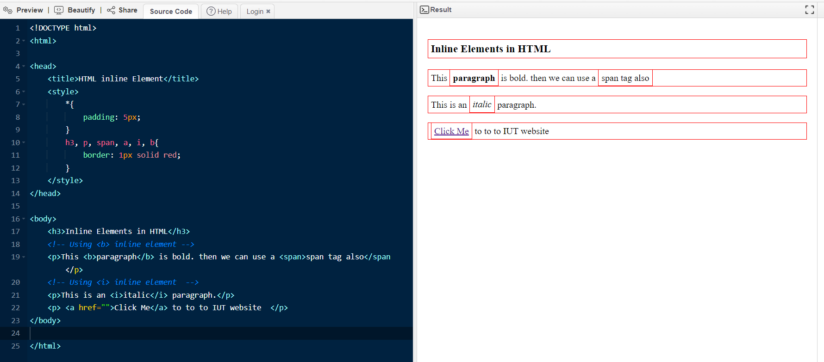
Contents
Example of Inline Elements borders

Slide 9
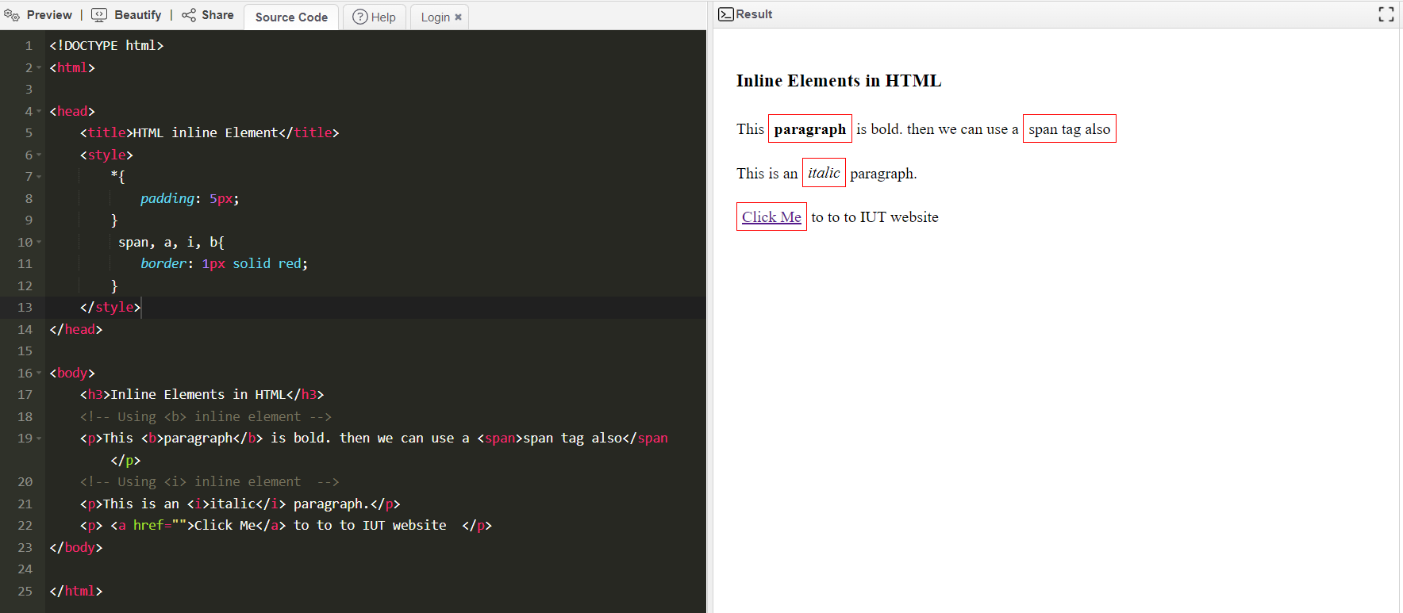
Contents
Example of Inline Elements borders

Slide 10
Contents
Grouping HTML Block and Inline Elements
There are two ways to group these elements;
Using <div> Tag
Using <span> Tag

Slide 11
Contents
Grouping using <div> Tag
The <div> tag is a block level element which plays a big role in grouping various other HTML tags and applying CSS on group of elements.
<div> tag can be used to create webpage layout where we define different parts (Left, Right, Top etc.) of the web page.
This tag does not provide any visual change on the block but this has more meaning when it is used with CSS.

Slide 12
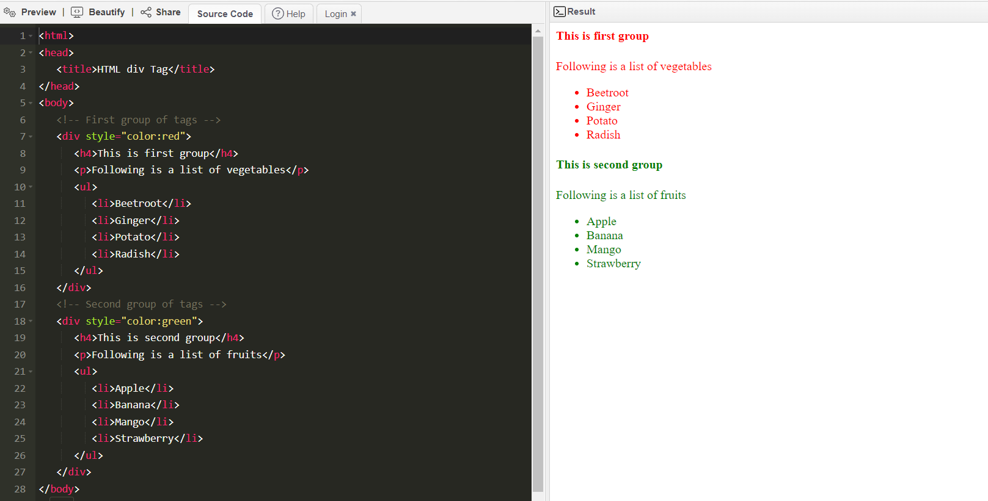
Contents
Example of div element

Slide 13
Contents
Grouping using <span> Tag
The HTML <span> is an inline element and it can be used to group inline-elements in an HTML document. This tag also does not provide any visual change on the block but has more meaning when it is used with CSS.
The difference between the <span> tag and the <div> tag is that the <span> tag is used with inline elements whereas the <div> tag is used with block-level elements.

Slide 14
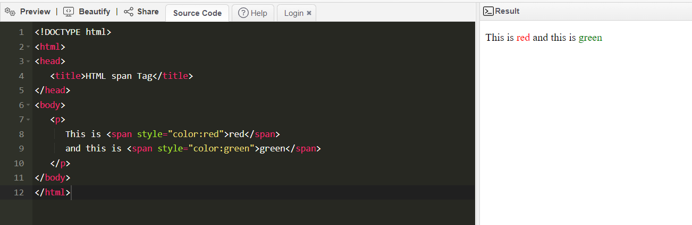
Contents
Example of span element

Slide 15
ANY QUESTION ?
THANK YOU !

Slide 16
References
References
[1] W3school.com
[2] https://www.tutorialspoint.com/

